Slide 1
Understanding Exception Types

Slide 2
Overview
Exceptions as classes
Handling exceptions by type Checked vs. unchecked exceptions Exceptions and methods

Slide 3


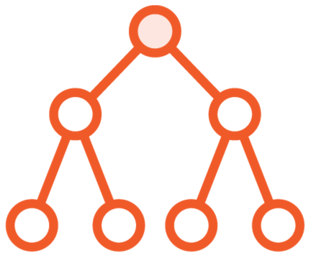
Exceptions Are Represented by Classes
All Inherit from Exception class
Some classes represent broad category of exceptions
Some classes represent more specific exceptions

Slide 4
Exception Class Hierarchy
Object
Throwable Exception
. .. .. .
IOException
RuntimeException
. . .
FileNotFoundException
SSLException
. .. .. .
ArithmeticException
. .. .. .
. . .
. . .
. .. .. .
. . .

Slide 5




Exceptions Can Be Handled by Type
A try can have multiple catches associated with it
Tested in order from top-to-bottom
First assignable catch is selected
Place more specific exceptions before less specific exceptions

Slide 6

System.out.println(result);
Main.java
int | i = | 12
int | j = | 2;
try | {
 | int | result = i / (j - 2);
} catch (Exception ex) {
System.out.println("Error: " + ex.getMessage());
} catch (ArithmeticException ex) {
System.out.println(“Invalid math operation - " + ex.getMessage());
}

Slide 7
System.out.println(result);
Main.java
int | i = | 12
int | j = | 2;
try | {
 | int | result = i / (j - 2);
} catch (ArithmeticException ex) {
System.out.println(“Invalid math operation - " + ex.getMessage());
} catch (Exception ex) {
System.out.println("Error: " + ex.getMessage());
}

Slide 8


Exceptions Fall into Two Broad Categories
In both cases, your program will crash if an exception gets thrown but is not caught
Checked exceptions
Compiler raises an error if not handled
Unchecked exceptions
Compiler does not enforce handling

Slide 9
Exception Class Hierarchy
Object
Throwable Exception
. .. .. .
IOException
RuntimeException
. . .
FileNotFoundException
SSLException
. .. .. .
ArithmeticException
. .. .. .
. . .
. . .
. .. .. .
Unchecked exceptions
Checked exceptions
. . .

Slide 10


Exceptions and Methods
Exceptions can cross method boundaries
If not handled, will propagate up the call stack
An exception thrown within a method can be caught by the code that called the method

Slide 11



Exceptions and Methods
void methodA() {
try {
methodB();
} catch (. . .) {
. . .
methodA
methodB
void methodB() {
}
. . .
}
methodC();
void methodC() {
methodC
}
// Does something
// that throws an
// exception
}

Slide 12
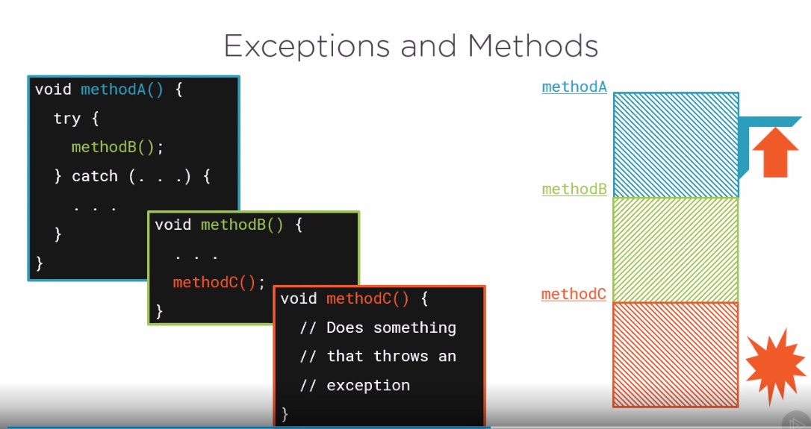

Slide 13

Exceptions Are Part of a Method’s Contract
A method must deal with any checked exceptions
Catch the exception
Document that exception might occur
Use the throws clause

Slide 14

Summary
Exceptions are represented by classes
All inherit from the Exception class
Some represent broad set of errors
Some represent very specific errors

Slide 15
Summary
Exceptions can be handled by type
A try can have multiple catches
Tested in order from top-to bottom
A catch will handle the exception type or a type that inherits from that type

Slide 16
Checked exceptions
Summary
- Compiler raises an error if not handled
Unchecked exceptions
Compiler does not enforce handling
Will crash your program if thrown and not handled

Slide 17
Exceptions can cross method boundaries
Summary
- Can handle an exception thrown by a method your code calls
Exceptions part of a method’s contract
Can catch exception
Can document exception with throws

